Slide 1
Loan Fundamentals

Slide 2
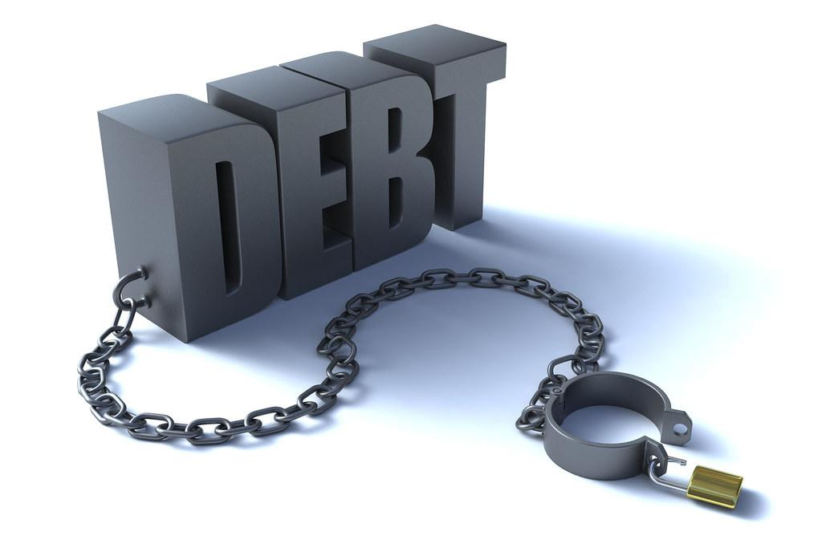
You Will Learn to Do:
Differentiate between amortized installment loans and revolving credit lines
Read an amortization table and understand how the payments are structured
Consider whether taking out a loan is a good or bad idea in a given circumstance

Slide 3
Essential Questions and Discussion
How is loan repayment different from credit card repayment?
How does amortization work? And what is an amortization table?
What should you consider before taking out a loan?

Slide 4
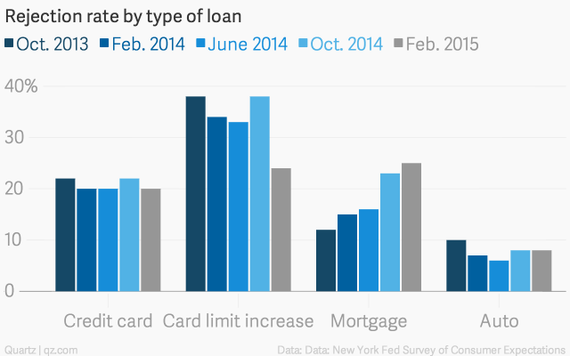
How Easy Is It To Get a Loan?
Complete the worksheet DATA CRUNCH: How Easy is it to Get a Loan? As a class.

Slide 5
Understanding How Loan Payments Work!
After watching the video, we will discuss as a class using the following guiding questions:
When loan payments are amortized, the total amount you owe every month _________________.
Why does the amount of INTEREST you owe decrease every month?
What happens to the principal paid over time?

Slide 6
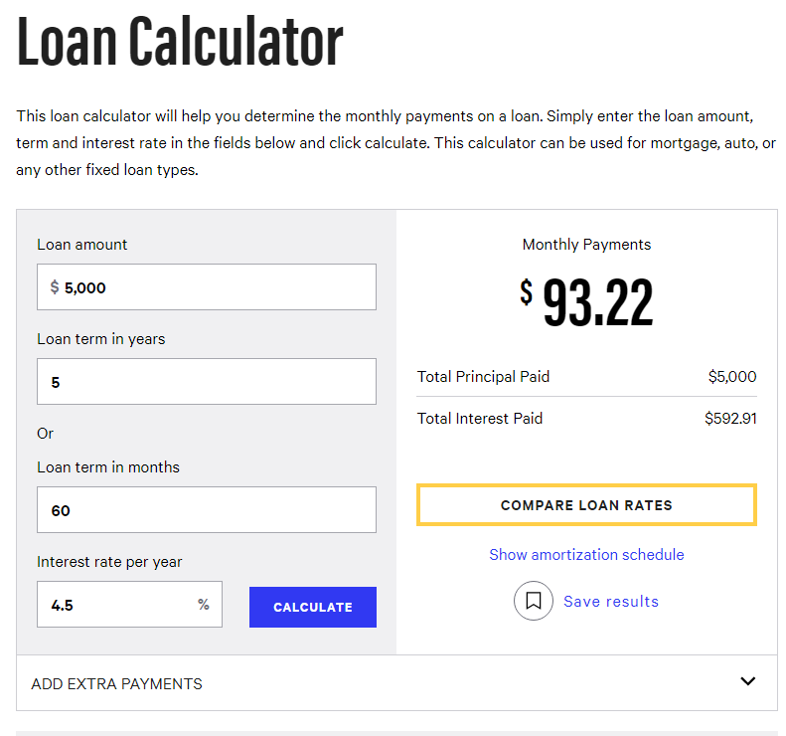
Analyze: Understanding Amortization
Now that you’ve learned a little about amortized loans, we will dive into the math to understand the topic a little deeper. Follow the directions on the attached sheet to complete the activity.
ANALYZE: Understanding Amortization

Slide 7
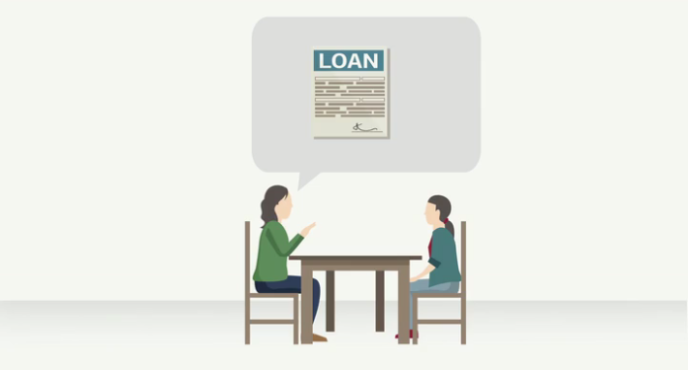
Preparing Kids to Make Borrowing Decisions
Credit cards and loans each come with their own advantages and disadvantages. And taking on some credit and using it responsibly helps you build a solid credit history for the future. Watch this video and answer the questions on the next slide. Discuss as a class when completed.

Slide 8
Preparing Kids to Make Borrowing Decisions
What should you consider before taking on debt?
The video suggests you consider these 4 things before deciding to take out a loan: Is it necessary? Do the monthly payments fit in your budget? Could you save instead of borrow? Is it worth the added interest?
If you were trying to decide whether to take out an auto loan for $6500 to buy your first car, thereby allowing you to commute for an impressive summer internship program next year, would that loan meet the requirements?

